Slide 1
Resources for Citizen Planners
Heather R. Shank, Director
Office of Planning & Development
Southwest Regional Planning Commission
Annual Meeting
June 11, 2024
Notes:
At 8:55 AM: Good morning everyone! We are going to start the session in 5 minutes. Your camera and mic are turned off by default for the duration of the session. We will be allowing people to unmute during the Q&A part of the session.
At 9:00 AM: Good morning everyone! Welcome to OPD’s 29th annual spring planning and zoning conference! This is the Planning Board track.

Slide 2
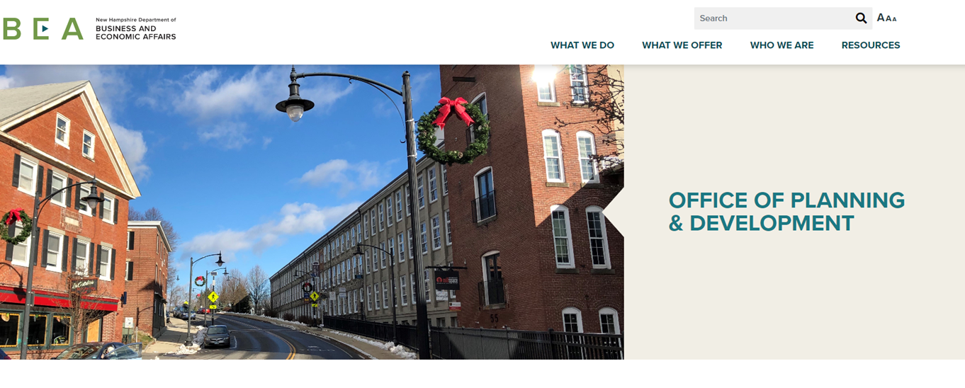
Main Functions:
Floodplain Management (NFIP)
State Data Center (dwelling unit surveys)
GIS (NH GRANIT, Zoning Atlas)
Municipal & Regional Planning Assistance
Office of Planning & Development

Slide 3
Municipal & Regional Planning Assistance
Citizen Resources for Planning & Zoning:
Planning & Zoning Handbooks
Monthly Webinars
Annual Conferences
Plan-Link Listserv
A to Z Subject List
Other Publications
NH Housing Toolbox

Slide 4
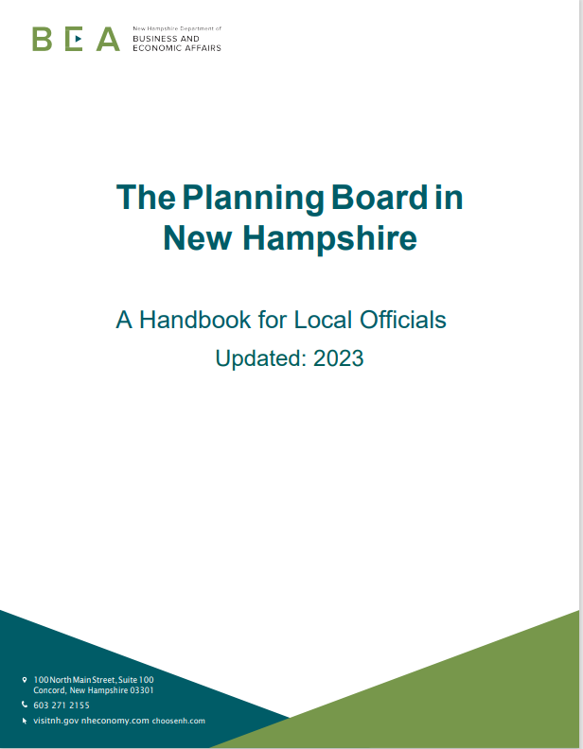
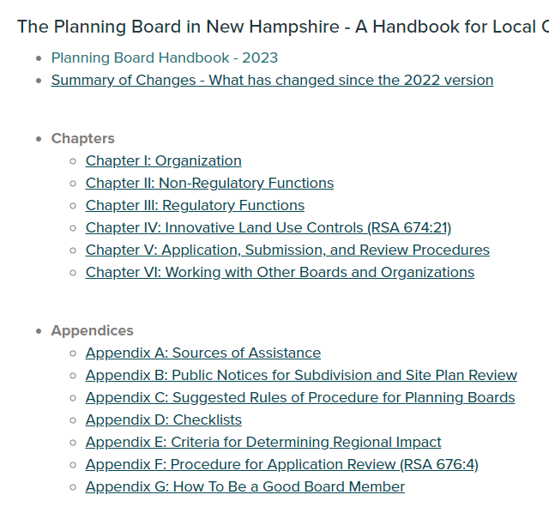
Municipal & Regional Planning Assistance
Planning & Zoning Handbooks

Slide 5
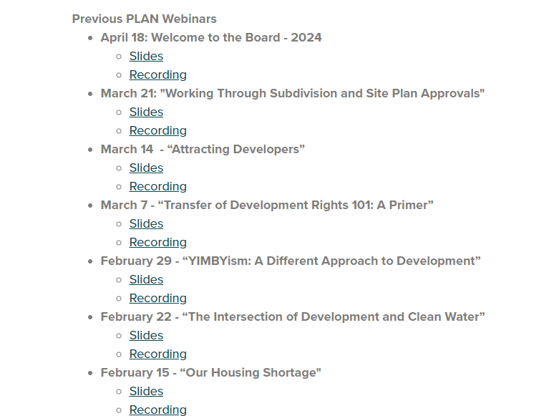
Municipal & Regional Planning Assistance
Monthly Webinars

Slide 6
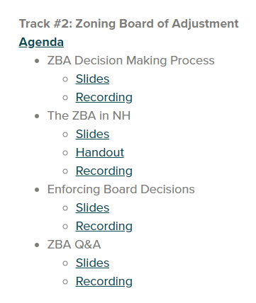
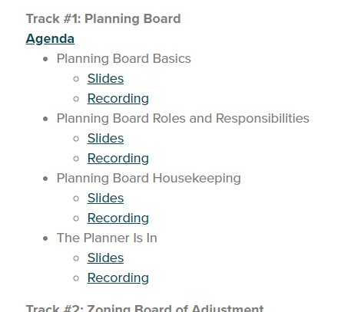
Municipal & Regional Planning Assistance
Annual Conference

Slide 7
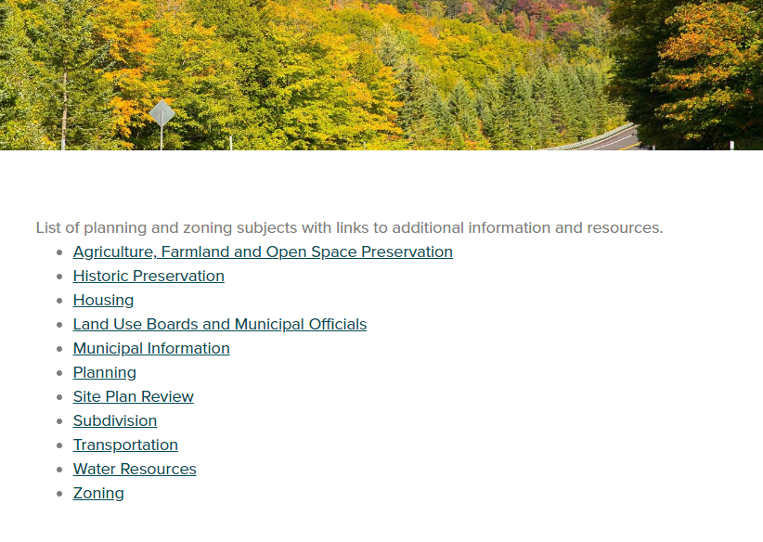
Municipal & Regional Planning Assistance
A to Z Subject List

Slide 8
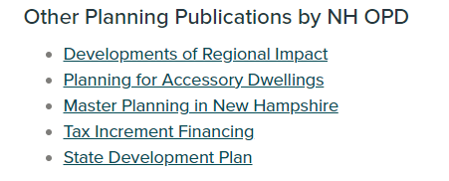
Municipal & Regional Planning Assistance
Other Publications

Slide 9
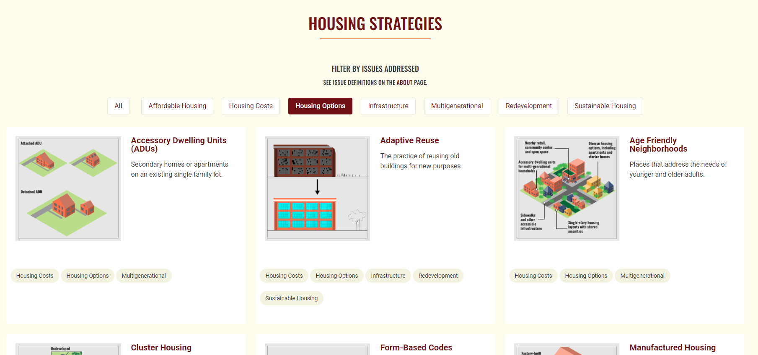
Municipal & Regional Planning Assistance
NH Housing Toolbox

Slide 10
Municipal & Regional Planning Assistance
Innovation from Land Use Boards
Register
Questions?

